Slide 1
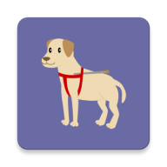
Guardian Eyes
Final Presentation
김준호, 노길호, 이경준, 설진환, 이재필

Slide 2





Contents
Recap & Changes
Demonstration
Recap Idea
Rescope from midterm
Usage Scenarios
Demo Video
Technical Details
Project Management
Conclusion
System architecture Overview
Technical Challenge
Approach & Solution
Timeline
Role & Contribution
Conclusion
Lesson learnt

Slide 3
Recap & Changes
Part.1

Slide 4

Recap
Motivation
: 모바일 환경을 이용한 시각장애인들을 위한 안내 도우미
Proposed Idea
: Tensorflow + ARcore + Sound feedback
Novelty
: Vision-based approach

Slide 5
Rescope from midterm
Before midterm
계단 등 바닥 장애물들을 custom deeplearning model을 통해 감지
After midterm
Custom deeplearning model을 개발하지 않고, Google AR Core의 기능을 이용해 지면 감지를 구현

Slide 6
Demo
Part.2

Slide 7
Demo

Slide 8
Technical details
Part.3

Slide 9








Technical details
DEVELOPMENT ENVIRONMENT

Slide 10
Technical details
SYSTEM ARCHITECTURE
Arduino
Obstacle
App
AR Core
Floor detection
Plane
Hole
OpenGL
Object tracking
Object detection
Tensorflow Lite

Slide 11
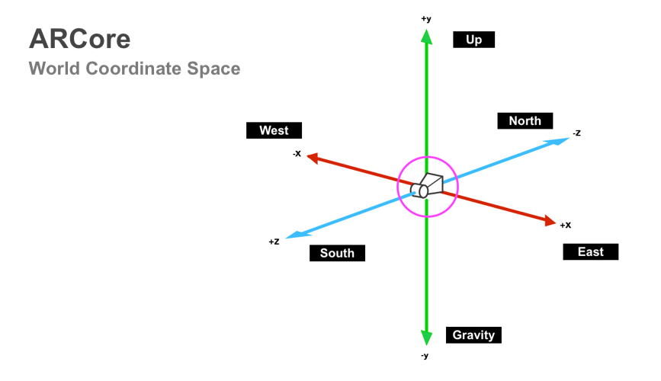
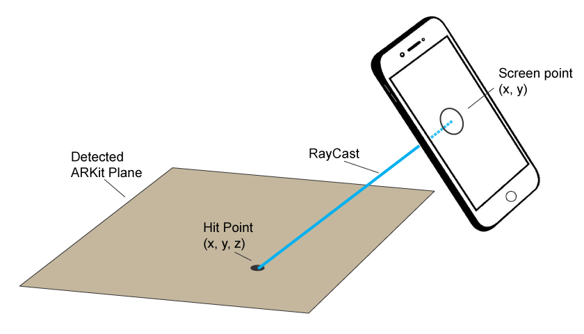
Technical details
(1) AR CORE : Floor detection
Approach
Real-world 3d coordinate system
Get location of plane

Slide 12
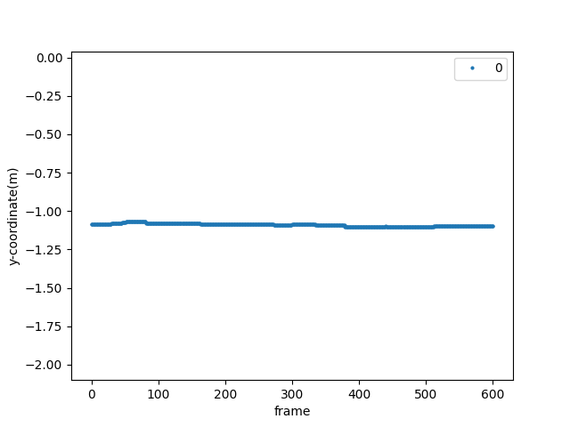
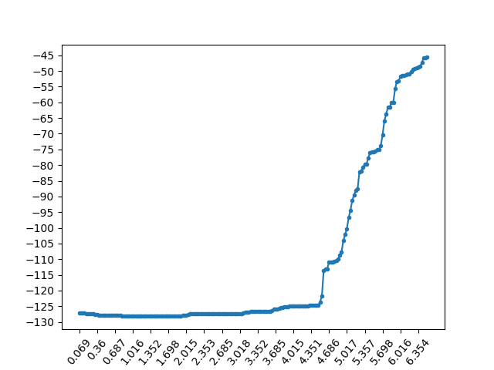
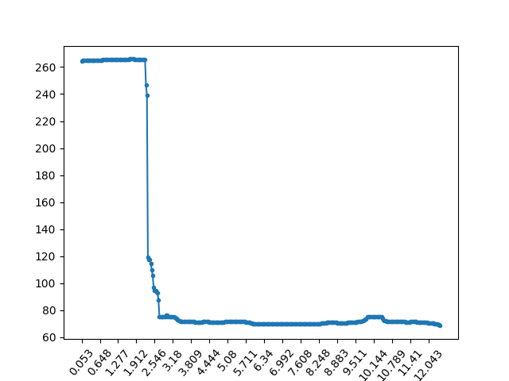
Technical details
(1) AR CORE : Floor detection
Data
Plane
Obstacle
Hole

Slide 13
Technical details
(1) AR CORE : Floor detection
Slope Threshold
Implementation
If (data.slope > threshold1)
state = ‘Obstacle’
else if (data[start] - data[end] > threshold2)
state = ‘Hole’
else
state = ‘Plane’
Height difference

Slide 14
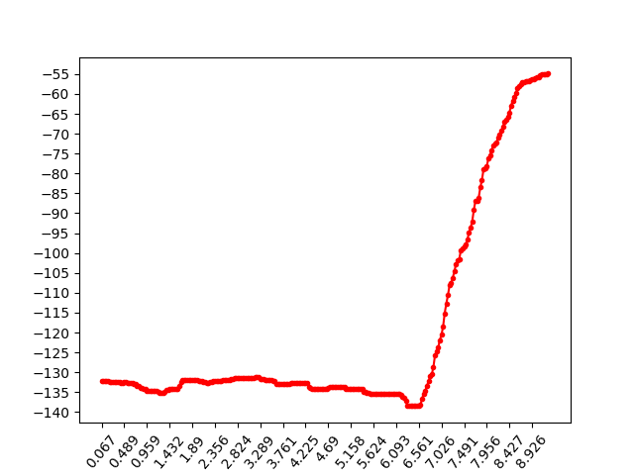
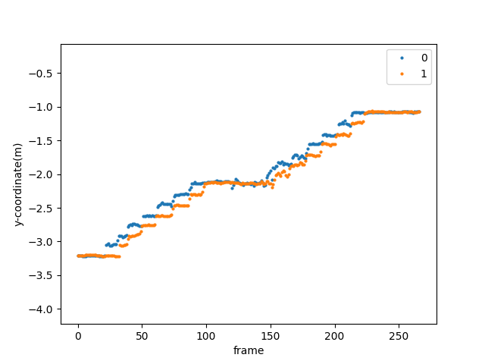
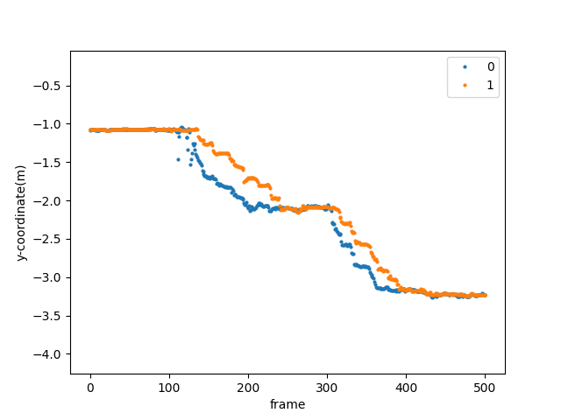
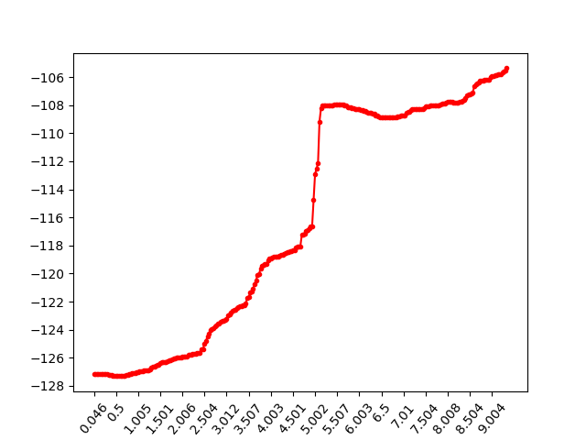
Technical details
(1) AR CORE : Floor detection
Furthermore
Wall
Upstair
Downstair
Raised spot

Slide 15
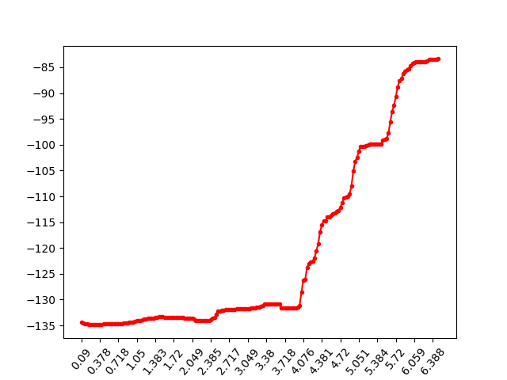
Technical details
(1) AR CORE : Floor detection
Challenges 1.
Wall
Upstair
→ There's not much difference in a short term.

Slide 16
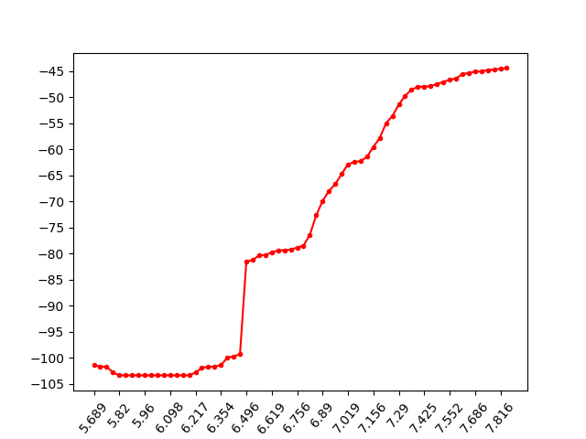
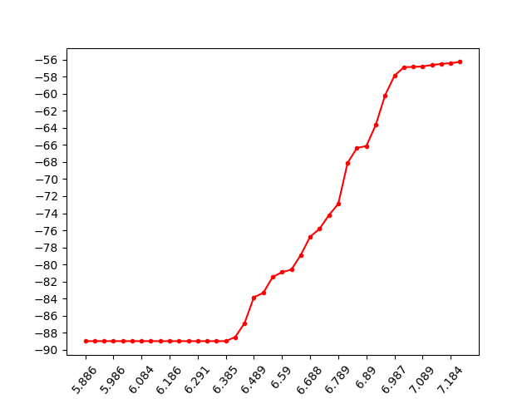
Technical details
(1) AR CORE : Floor detection
Challenges 2.
→ Difference in data according to the walking speed.

Slide 17
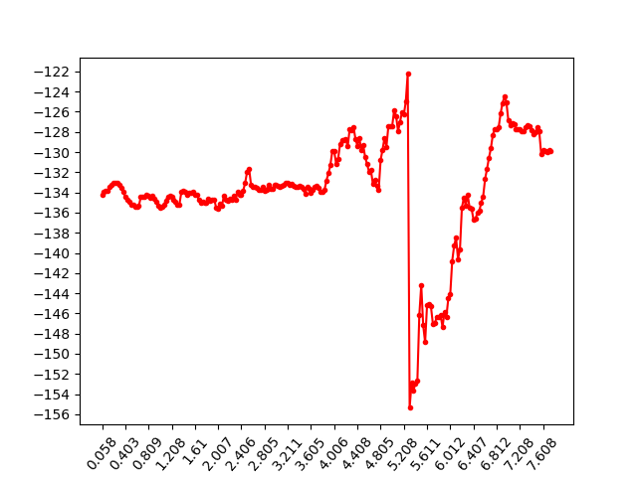
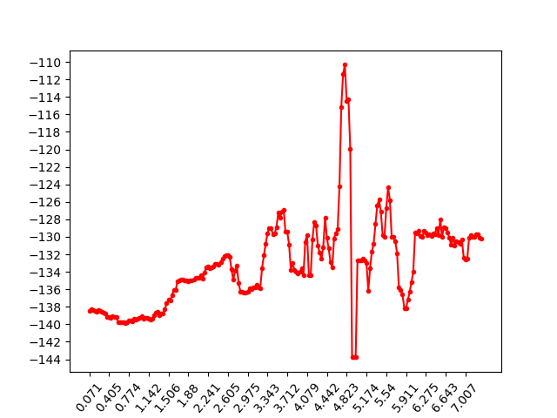
Technical details
(1) AR CORE : Floor detection
Challenges 3.
→ Too much noise in data

Slide 18
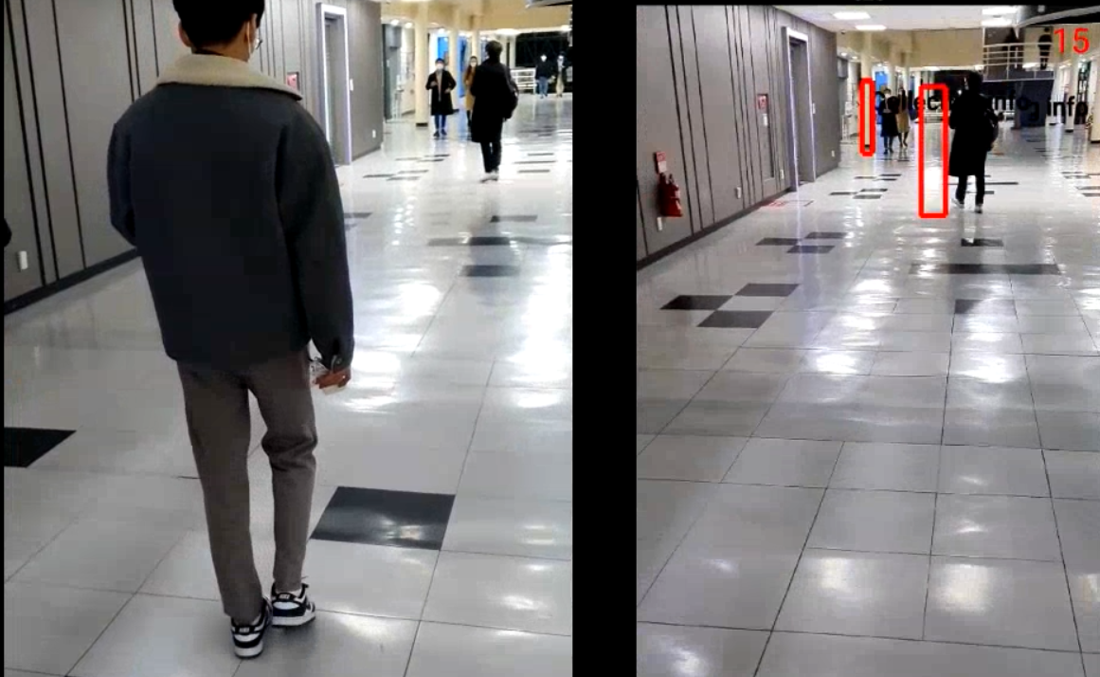
Technical details
(1) AR CORE : Floor detection
Challenges 4.
→ Error occured by illuminance of surfaces

Slide 19
Technical details
(1) AR CORE : Floor detection
Possible Solution
Use a good noise cancellation algorithm
State classification with deep learning
Improve performance of AR Core

Slide 20
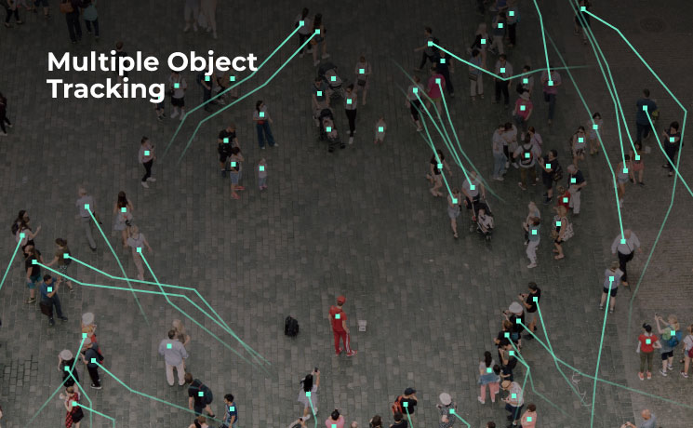
Technical details
(2) OBJECT TRACKING : object detection
Approach
Warning in advance
if there’s an object at risk of hitting

Slide 21
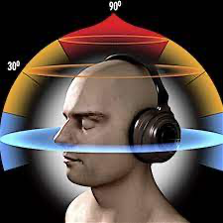
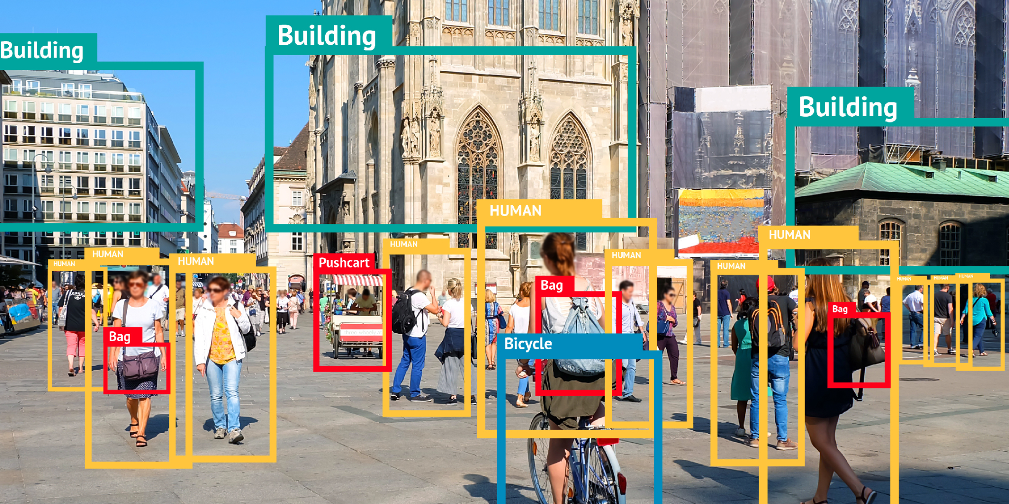
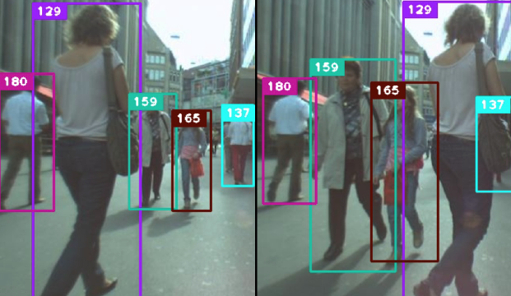
Technical details
(2) OBJECT TRACKING : object detection
Structure
3D sound feedback
Object detection
Object tracking with SORT Algorithm

Slide 22
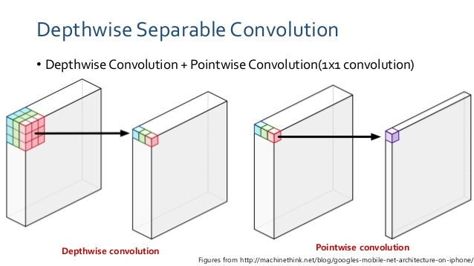

Technical details
(2) OBJECT TRACKING : object detection
Object detection
Mobilenet v1
Coco dataset

Slide 23
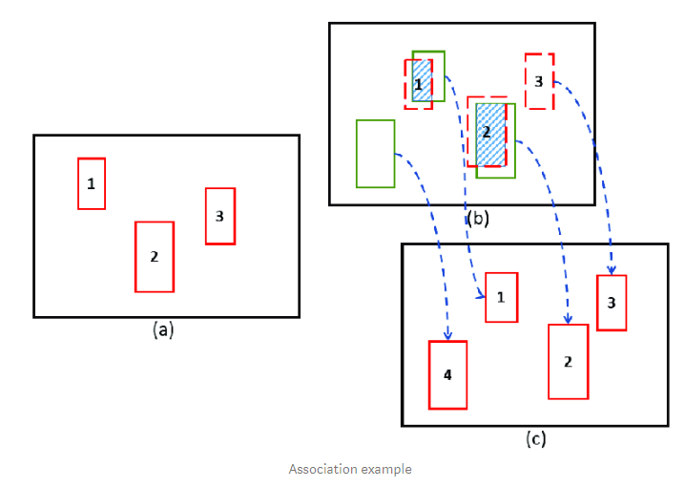
Technical details
(2) OBJECT TRACKING : object detection
Object tracking : SORT(Simple Online Real-time Tracking)
Kalman Filter
Hungarian Algorithm

Slide 24
Technical details
(2) OBJECT TRACKING : object detection
3D sound feedback
GVR Audio Engine
Google VR

Slide 25
Technical details
(2) OBJECT TRACKING : object detection
B
Detailed Implementation
A
A
B
Feedback

Slide 26
Technical details
(2) OBJECT TRACKING : object detection
Limitation
Too much noise in data → Velocity vector is not accurate
Solution
Take a long frame to calculate the velocity vector
Use a function in GVR audio engine

Slide 27
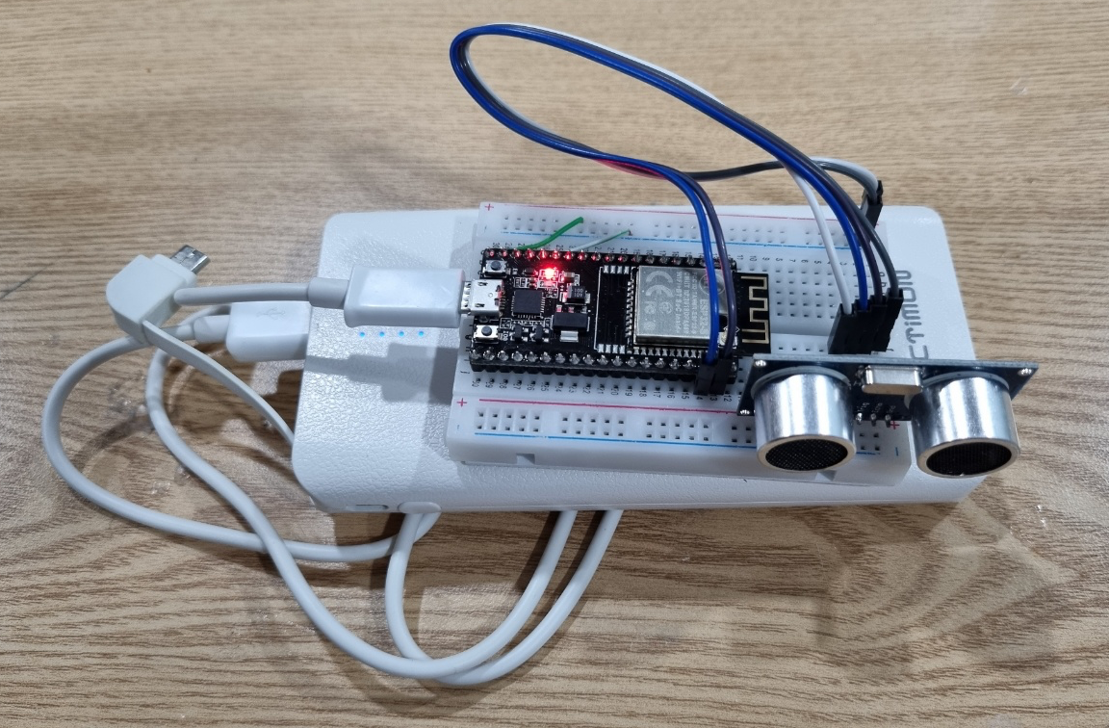
Technical details
(3) ARDUINO : 그 외 위험요소 감지
Arduino gives vibrate feedback
when object approaches from blind spot!

Slide 28
Technical details
Evaluation and Success Criteria
사용 기기별 FPS
측정 기기 | 갤럭시 S21+ | 갤럭시 S20 | 갤럭시 노트10 | 갤럭시 S10 | 갤럭시 S9
FPS | 28 | 25 | 20 | 17 | 5
Notes:
False Positive(장애물이 있는데 감지를 못하는 상황)은 없었다.
실패한경우는 전부 없는 물체를 잘못 감지한경우(FN)이다.
아래 채점표에서 성공한 횟수와 잘못탐지한 횟수
참고: ACCURACY = (TP + TN) / (TP+TN+FP+FN) 인데 FN, TN 이 없음

Slide 29
Technical details
Evaluation and Success Criteria
Accuracy = (TP+TN) / (TP+TN+FP+FN)
Precision = TP / (TP+FP)
Recall (검출률) = TP / (TP+FN)
# of FN = 0, 위험이 있는데 감지하지 못하는 상황은 없었다!
Recall = 100%
Accuracy = Precision
Notes:
False Positive(장애물이 있는데 감지를 못하는 상황)은 없었다.
실패한경우는 전부 없는 물체를 잘못 감지한경우(FN)이다.
아래 채점표에서 성공한 횟수와 잘못탐지한 횟수
참고: ACCURACY = (TP + TN) / (TP+TN+FP+FN) 인데 FN, TN 이 없음

Slide 30
Technical details
올라가는 계단
평가항목 | 감지 성공 | 위험이 없는데 감지 | Accuracy(%)
Stationary object | - | 4 | 0
Moving object | 1 | 0 | 100
Obstacle | 2 | 0 | 100
Hole | - | 0 | -
총계 | 3 | 4 | 43

Slide 31
Technical details
내려가는 계단
평가항목 | 감지 성공 | 위험이 없는데 감지 | Accuracy(%)
Stationary object | - | 4 | 0
Moving object | 5 | 0 | 100
Obstacle | - | 2 | 0
Hole | 2 | 0 | 100
총계 | 7 | 6 | 54

Slide 32
Technical details
강의실
평가항목 | 감지 성공 | 위험이 없는데 감지 | Accuracy(%)
Stationary object | 3 | 0 | 100
Moving object | - | 0 | 0
Obstacle | - | 0 | 0
Hole | - | 0 | 0
총계 | 3 | 0 | 100

Slide 33
Technical details
301동 1층, 실제 상황
평가항목 | 감지 성공 | 위험이 없는데 감지 | Accuracy(%)
Stationary object | 3 | 3 | 50
Moving object | 5 | 0 | 100
Obstacle | 1 | 4 | 20
Hole | - | 2 | 0
총계 | 9 | 9 | 50

Slide 34
Conclusion
1. 어려운 주제였음에도 적절한 scope 조절과 많은 heuristic을 통해 모든 위험을 감지하는데 성공했다.
2. 정확도는 50%를 달성하였다.
3. 하드웨어의 한계 내에서 가능한 최선의 성능을 끌어내는데 성공하였다.
Notes:
(교수님의 조언을 받아)

Slide 35
Project management
Part.4

Slide 36
Project management
(1) TIMELINE
MIDTERM PRESENTATION
OBJECT TRACKING
IDEA THINKING
MOBILE APP 시스템구축
REPLACE floor detecting model with ARCORE
COMBINE object tracking with ARCORE
주제설정
UI 개발
1주차
3주차
6-7주차
10주차
2주차
4-5주차
8-9주차
Today
MODEL TEST
FLOOR DETECTION HEURISTICS STUDY
GUARDIAN EYES PROJECT 시작
Final PRESENTATION
COMBINE custom ML model with ARCORE
FIND proper threshold
Make guardian eyes successful
model training
data collection
ARCORE 조사

Slide 37
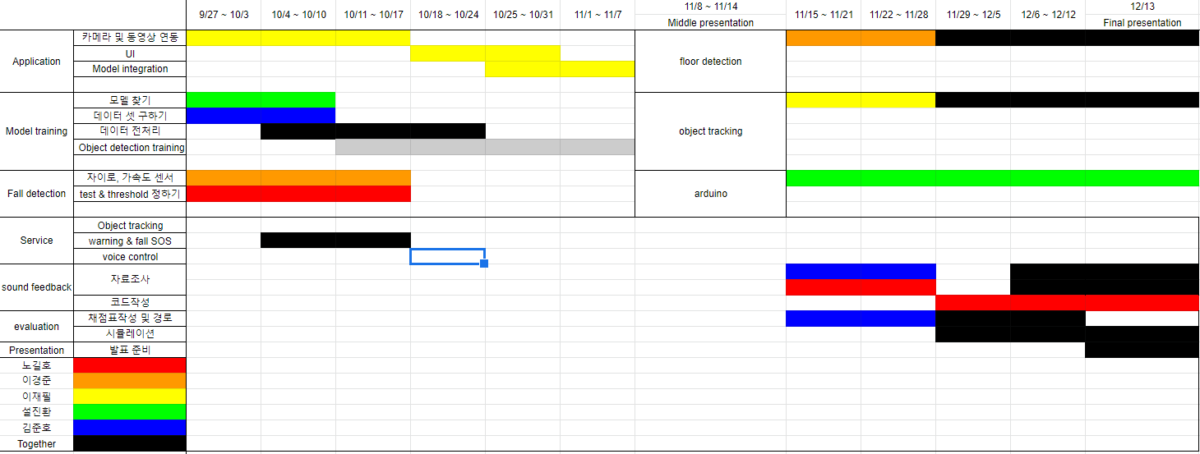
Project management
(2) ROLES AND CONTRIBUTIONS

Slide 38
Lesson learnt
LIMITATION IN MOBILE APP
THE IMPORTANCE OF DEEP LEARNING TO OBJECT DETECTION & CLASSIFICATION
VARIOUS RESEARCH TOPICS REMAIN IN MOBILE RESEARCH

Slide 39
Thank you for listening

